Slide 1

Go, change the world
RV College of
Engineering
Operating Systems

Slide 2
Go, change the world
Overview of Syllabus
RV College of
Engineering
Unit 1- Introduction Introduction What Operating System do, Operating System structure, Operating system Operations. System Structures Operating system services, System Calls, Types of System calls Process Management Process concept, Process scheduling, Operations on processes
Unit-2 Multithreaded programming Overview, Multicore programming, Multithreading models, Thread libraries - pthreads CPU scheduling and Process Synchronization Basic concepts, scheduling criteria, scheduling algorithms-FCFS, SJF, RR, priority, Real-time CPU scheduling
Unit 3- Process Synchronization Background, The Critical section problem, Peterson’s Solution Process Synchronization hardware, Mutex locks, Semaphores, Classic problems of synchronization
Unit 4- Main Memory Management Background, Swapping, Contiguous memory allocation, Segmentation, Paging, Structure of page table. Virtual memory Background, Demand Paging, Copy-on-write, Page replacement, Allocation of frames, Thrashing
Unit -5 File Systems File Naming, File Structure, File Types, File Access, File Attributes, File Operations, An example program using File-System calls, File-System Layout, Implementing Files

Slide 3
Go, change the world
Why we need Operating System
RV College of
Engineering
Communicate with the computer
Learn concurrency, resource management, performance analysis, interfaces with complexity and computer system design of a computer system Operating System should be learnt
Build or modify real operating system.
Tune application performance. Understanding the services offered by an operating system will influence how you design applications.
Administer and use system well. You will develop a better understanding of the structure of modern computing systems, from the hardware level through the operating system level and onto the applications level.
Can apply techniques used in an OS to other areas;
interesting, complex data structures
conflict resolution
concurrency
resource management
Challenge of designing large and complex systems

Slide 4
Go, change the world
What Operating Systems Do
RV College of
Engineering
A program that acts as an intermediary between a user of a computer and the computer hardware
Operating system goals:
Execute user programs and make solving user problems easier
Make the computer system convenient to use
Use the computer hardware in an efficient manner
• Control Freak – Must never ever loose control of the hardware
• Resource Manager
Give resources to applications
Take resources from applications
Protection and Security
• Great Pretender
Make resources look different
Make finite resources appear as infinite resources

Slide 5
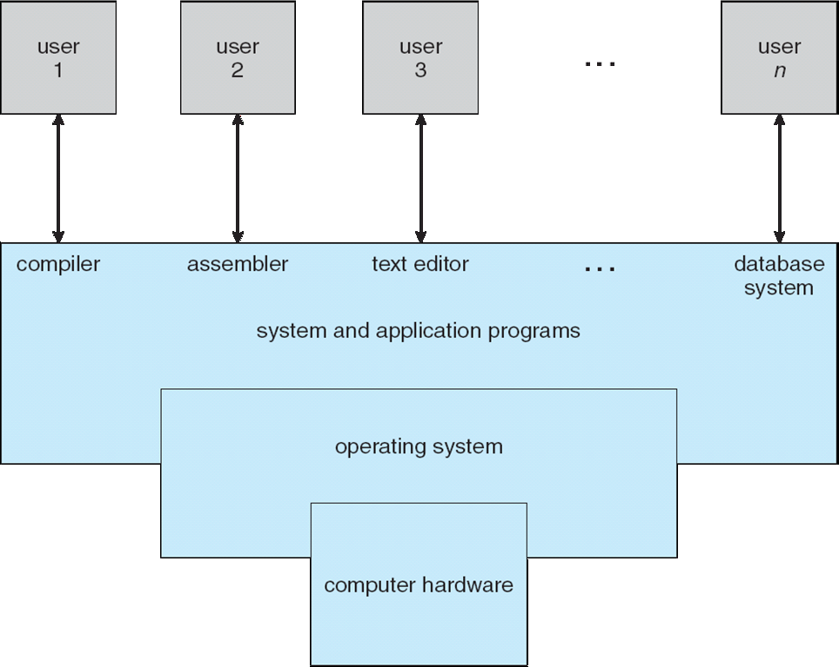
Go, change the world
Computer System Architecture
RV College of
Engineering
Interface
Resource Management
Process Management
Storage and Memory Management
Security
“The one program running at all times on the computer” is the kernel.
Application programs – define the ways in which the system resources are used to solve the computing problems of the users

Slide 6
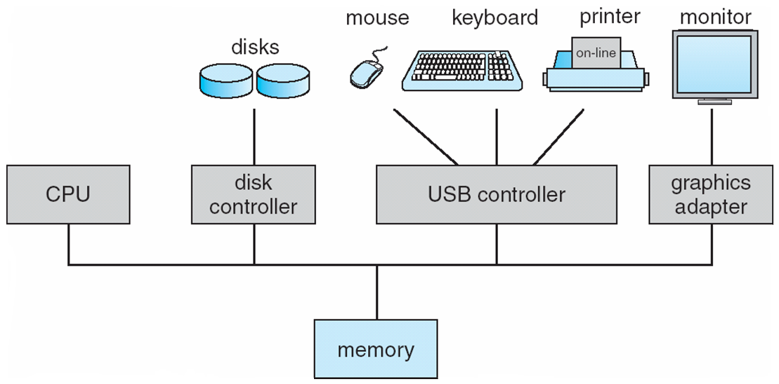
Go, change the world
Computer System Organization
RV College of
Engineering
Computer-system operation
One or more CPUs, device controllers connect through common bus providing access to shared memory
Concurrent execution of CPUs and devices competing for memory cycles
To ensure the memory access to all the devices we have Memory Controller

Slide 7
Go, change the world
Computer System Organization
RV College of
Engineering
Bootstrap Program
Initial Program that runs up when the system is powered
Typically stored in ROM or EPROM, generally known as firmware
Initializes all aspects of system
Loads operating system kernel and starts execution
Interrupt
The occurrence of the event is signaled by interrupt from Hardware and Software
Hardware may trigger an interrupt by sending the signal to CPU
System Call (Monitor Call)
Software may trigger the interrupt by sending the special signal that is called as system call or monitor call

Slide 8
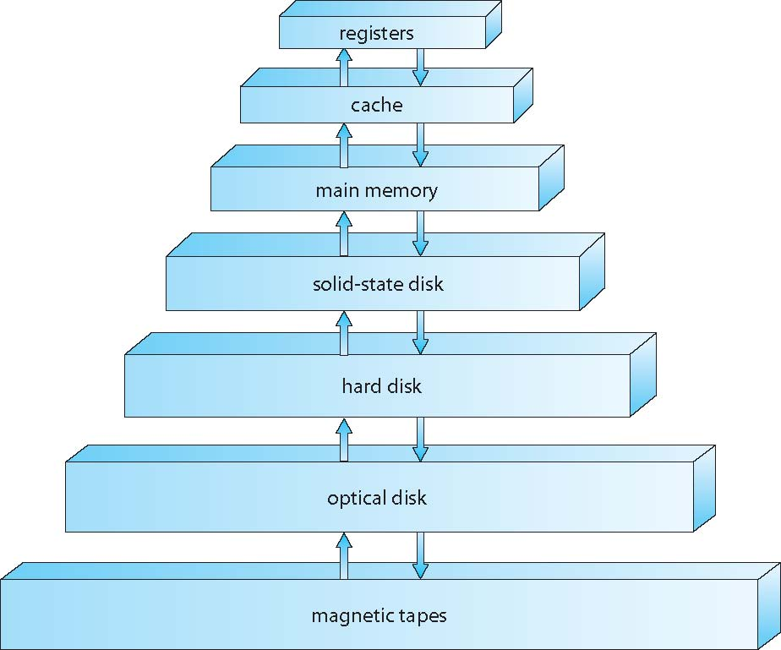
Go, change the world
Storage Structure
RV College of
Engineering
Bootstrap Program
Initial Program that runs up when the system is powered
Typically stored in ROM or EPROM, generally known as firmware
Initializes all aspects of system
Loads operating system
Expensive, Small in Size, Fast
Expensive, Larger in Size,
Access time increases
Storage systems organized in hierarchy
Speed
Cost
Volatility
Caching – copying information into faster storage system; main memory can be viewed as a cache for secondary storage

Slide 9
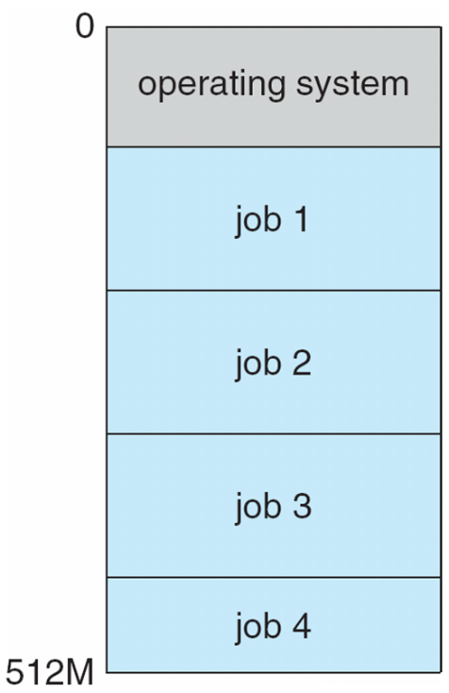
Go, change the world
Operating System Structure
RV College of
Engineering
Multiprogramming (Batch system) needed for efficiency
Single user cannot keep CPU and I/O devices busy at all times
Multiprogramming organizes jobs (code and data) so CPU always has one to execute
A subset of total jobs in system is kept in memory
One job selected and run via job scheduling
When it has to wait (for I/O for example), OS switches to another job
Multiprogrammed systems provide an environment in which the various system resources (for example, CPU, memory, and peripheral devices) are utilized effectively, but they do not provide for user interaction with the computer system

Slide 10
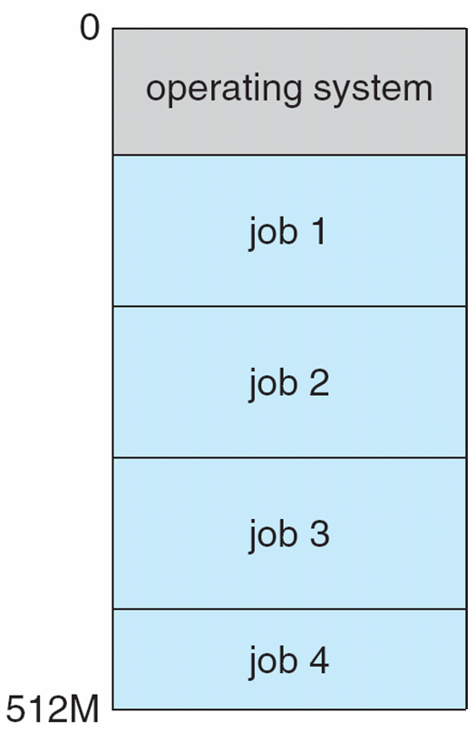
Go, change the world
RV College of
Engineering
Memory Layout for Multiprogrammed System

Slide 11
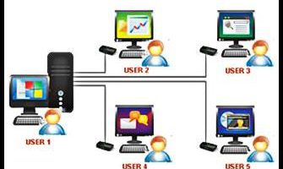
Go, change the world
RV College of
Engineering
Memory Layout for Multiprogrammed System
Timesharing (multitasking) is logical extension in which CPU switches jobs so frequently that users can interact with each job while it is running, creating interactive computing
CPU executes multiple jobs by switching among them, but the switches occur so frequently that the users can interact with each program while it is running
Response time should be < 1 second
A program loaded into memory and executing is called.Process
If several jobs ready to run at the same time  CPU scheduling
If processes don’t fit in memory, swapping moves them in and out to run
Virtual memory allows execution of processes not completely in memory

Slide 12
Go, change the world
RV College of
Engineering
Operating-System Operations
Interrupt driven (hardware and software)
Hardware interrupt by one of the devices
Software interrupt (exception or trap):
Software error (e.g., division by zero)
Request for operating system service
Other process problems include infinite loop, processes modifying each other or the operating system
The operating system and the users share the hardware and software resources of the computer system, we need to make sure that an error in a user program could cause problems only for the one program that is running.

Slide 13
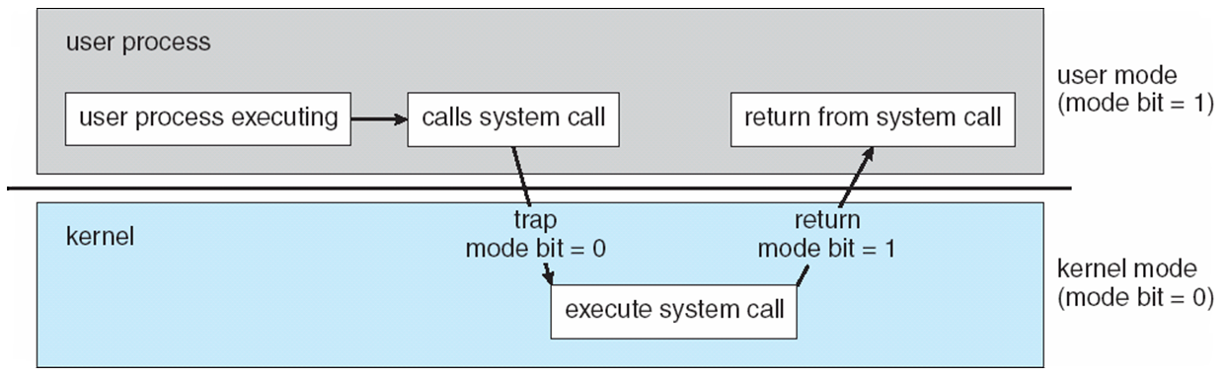
Go, change the world
RV College of
Engineering
Operating-System Operations (cont.)
Dual-mode operation allows OS to protect itself and other system components
User mode and kernel mode
Mode bit provided by hardware
Kernel (0) and User(1)
When the computer system is executing on behalf of a user application, the system is in user mode. a user application requests a service from the operating system (via a system call), it must transition from user to kernel mode to fulfil the request.

Slide 14
Go, change the world
RV College of
Engineering
Operating-System Operations (cont.)
At system boot time, the hardware starts in kernel mode.
The operating system is then loaded and starts user applications in user mode.
Whenever a trap or interrupt occurs, the hardware switches from user mode to kernel mode (that is, changes the state of the mode bit to 0).
Thus, whenever the operating system gains control of the computer, it is in kernel mode.
The system always switches to user mode (by setting the mode bit to 1) before passing control to a user program.

Slide 15
Go, change the world
RV College of
Engineering
Operating-System Operations (cont.)
Provides ability to distinguish when system is running user code or kernel code
Some instructions designated as privileged, only executable in kernel mode
System call changes mode to kernel, return from call resets it to user
Increasingly CPUs support multi-mode operations

Slide 16
Go, change the world
RV College of
Engineering
Timer
Timer to prevent infinite loop / process hogging resources
operating system maintains control over the CPU. Prevent a user program from getting stuck in an infinite loop or not calling system services and never returning control to the operating system.
To accomplish this goal, we can use a timer.
Timer is set to interrupt the computer after some time period
Keep a counter that is decremented by the physical clock.
Operating system set the counter (privileged instruction)
When counter zero generate an interrupt
Set up before scheduling process to regain control or terminate program that exceeds allotted time

Slide 17
Go, change the world
Operating System Services
RV College of
Engineering
Operating systems provide an environment for execution of programs and services to programs and users
One set of operating-system services provides functions that are helpful to the user:
User interface - Almost all operating systems have a user interface (UI).
Varies between Command-Line (CLI), Graphics User Interface (GUI),
Program execution - The system must be able to load a program into memory and to run that program, end execution, either normally or abnormally (indicating error)
I/O operations - A running program may require I/O, which may involve a file or an I/O device

Slide 18
Go, change the world
RV College of
Engineering
Operating System Services
File-system manipulation - The file system is of particular interest. Programs need to read and write files and directories, create and delete them, search them, list file Information, permission management.
Communications – Processes may exchange information, on the same computer or between computers over a network, Communications may be via shared memory or through message passing (packets moved by the OS)
Error detection – OS needs to be constantly aware of possible errors
May occur in the CPU and memory hardware, in I/O devices, in user program
For each type of error, OS should take the appropriate action to ensure correct and consistent computing
Debugging facilities can greatly enhance the user’s and programmer’s abilities to efficiently use the system

Slide 19
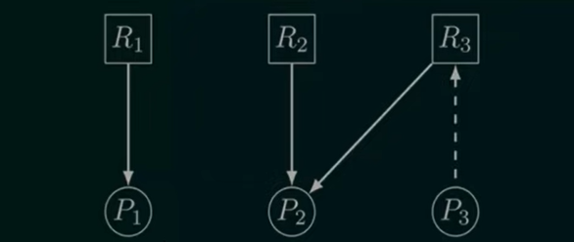
Go, change the world
RV College of
Engineering
Operating System Services
Resource allocation - When multiple users or multiple jobs running concurrently, resources must be allocated to each of them Many types of resources - CPU cycles, main memory, file storage, I/O devices.
Accounting - To keep track of which users use how much and what kinds of computer resources
Protection and security - The owners of information stored in a multiuser or networked computer system may want to control use of that information, concurrent processes should not interfere with each other
Protection involves ensuring that all access to system resources is controlled
Security of the system from outsiders requires user authentication, extends to defending external I/O devices from invalid access attempts

Slide 20
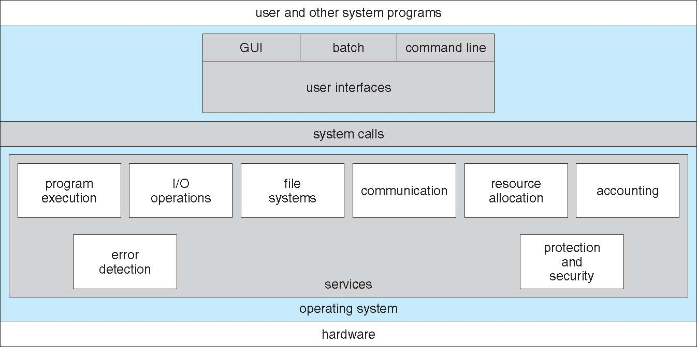
Go, change the world
RV College of
Engineering
Operating System Services

Slide 21
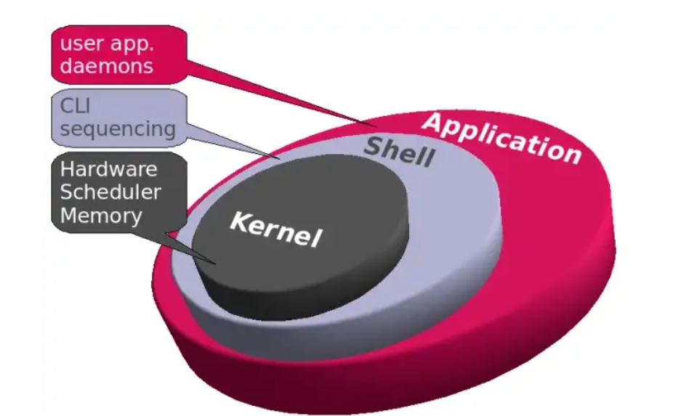
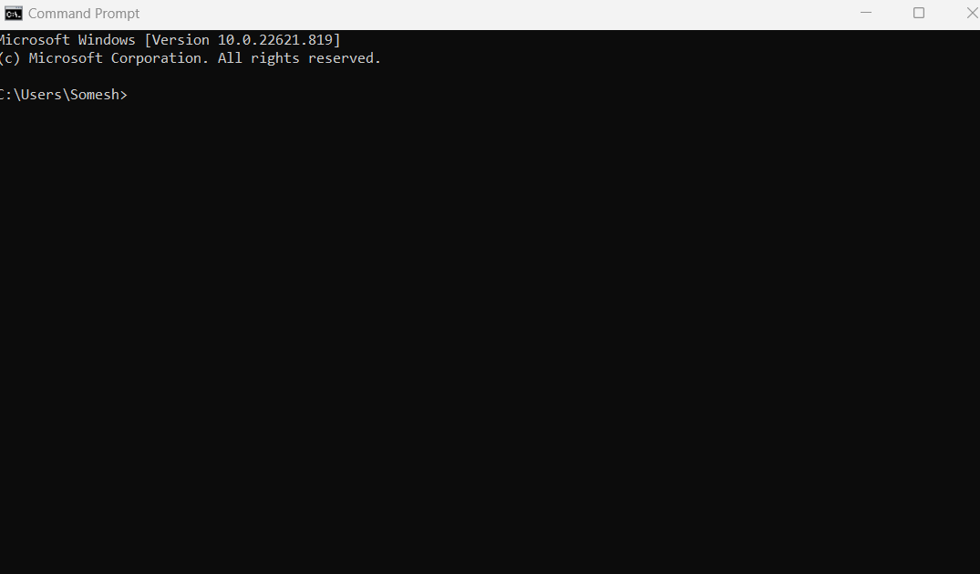
Go, change the world
RV College of
Engineering
User Operating System Interface - CLI
CLI or command interpreter allows direct command entry
Sometimes implemented in kernel, sometimes by systems program
shells - interface to the operating system
Primarily fetches a command from user and executes it
Sometimes commands built-in, sometimes just names of programs
If the latter, adding new features doesn’t require shell modification

Slide 22
Go, change the world
RV College of
Engineering
User Operating System Interface - CLI
User-friendly desktop metaphor interface
Usually mouse, keyboard, and monitor
Icons represent files, programs, actions, etc
Various mouse buttons over objects in the interface cause various actions (provide information, options, execute function, open directory (known as a folder)
Invented at Xerox PARC
Many systems now include both CLI and GUI interfaces
Microsoft Windows is GUI with CLI “command” shell
Apple Mac OS X is “Aqua” GUI interface with UNIX kernel underneath and shells available
Unix and Linux have CLI with optional GUI interfaces (CDE, KDE, GNOME)

Slide 23
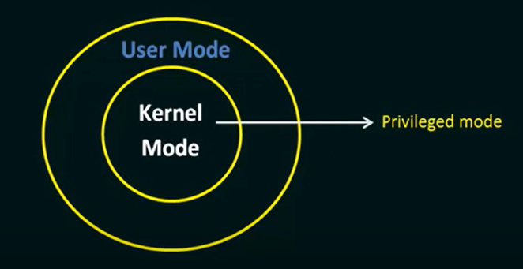
Go, change the world
RV College of
Engineering
System Calls
What is System Call in Operating System?
A system call is a mechanism that provides the interface between a process and the operating system. It is a programmatic method in which a computer program requests a service from the kernel of the OS.
System call offers the services of the operating system to the user programs via API (Application Programming Interface).
Typically written in a high-level language (C or C++)
System calls are the only entry points for the kernel system.
User Kernel ==== Mode Shifting
Mostly accessed by programs via a high-level Application Programming Interface (API) rather than direct system call use

Slide 24
Go, change the world
RV College of
Engineering
Example of System Call
Example of the system call to write the simple program to read the data from source file and copy to the destination file
Step-1 ---- Get the Input File Name (From which the data has to be copied)
Step-2 ---- Prompt on the Screen (User to Enter the Input File Name)
Step-3 ----- Accept the Input User has entered (Input File Name)
Step-4 -----Acquire the Output file name
Step-5------ Prompt on the Screen (User to Enter the Output File Name)
Step-6 ----- Accept the Input User has entered (Output File Name)
Step – 7 --- Open the Input File
Step-8 -- If the Input file doesn’t exist the pop up the error
Step – 9 -- Read from the Input file
Step-10 – Write to the Output file name ( Step 9 and 10 will be in loop until all the data is copied)
Step-11 – Show the message the coping is done
Step- 12 – Close both the files
To perform all these steps we will be requiring the system calls
SRC FILE
DEST FILE

Slide 25
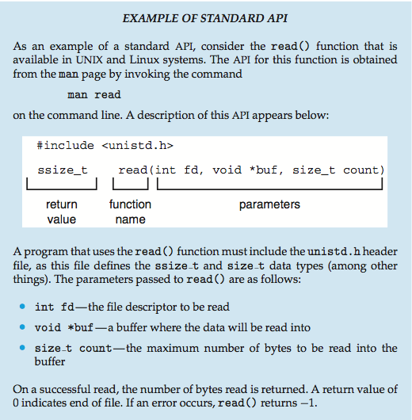
Go, change the world
RV College of
Engineering
Example of Standard API

Slide 26
Go, change the world
RV College of
Engineering
How System Call Works
Working of System call As you can see in the above-given System Call example diagram.
Step 1) The processes executed in the user mode till the time a system call interrupts it.
Step 2) After that, the system call is executed in the kernel-mode on a priority basis.
Step 3) Once system call execution is over, control returns to the user mode.,

Slide 27
Go, change the world
RV College of
Engineering
Why we require System calls
Reading and writing from files demand system calls.
If a file system wants to create or delete files, system calls are required.
System calls are used for the creation and management of new processes.
Network connections need system calls for sending and receiving packets.
Access to hardware devices like scanner, printer, need a system call.

Slide 28
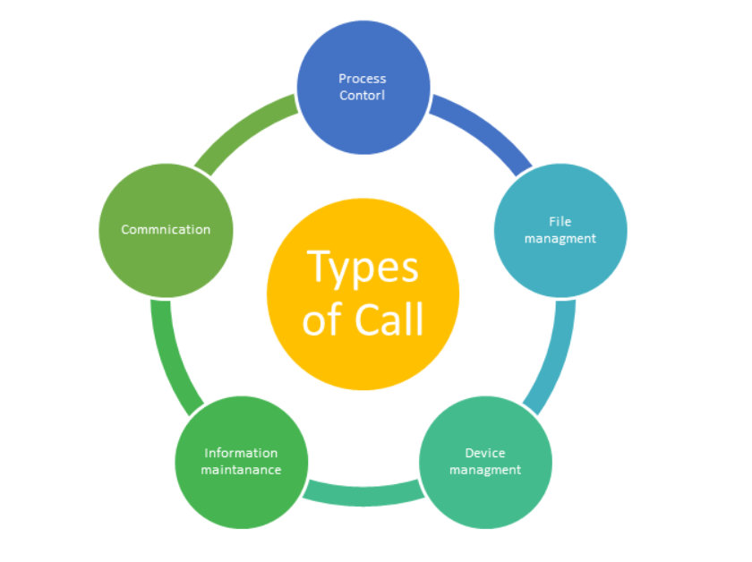
Go, change the world
RV College of
Engineering
Types of System calls

Slide 29
Go, change the world
RV College of
Engineering
Types of System calls
Process Control
This system calls perform the task of process creation, process termination, etc.
Functions:
End( Completes its execution )and Abort(When the errors occurs)
Load and Execute the process
Create Process and Terminate Process ( Getting the Process Attributes and Set attributes)
Wait and Signal Event
Allocate and free memory

Slide 30
Go, change the world
RV College of
Engineering
Types of System calls
Process Control
This system calls perform the task of process creation, process termination, etc.
Functions:
End( Completes its execution )and Abort(When the errors occurs)
Load and Execute the process
Create Process and Terminate Process ( Getting the Process Attributes and Set attributes)
Wait and Signal Event
Allocate and free memory (Allocate the

Slide 31
Go, change the world
RV College of
Engineering
Types of System calls
File Management
File management system calls handle file manipulation jobs like creating a file, reading, and writing, etc.
Functions:
Create a file
Delete file
Open and close file
Read, write, and reposition
Get and set file attributes

Slide 32
Go, change the world
RV College of
Engineering
Types of System calls
Device Management
Device management does the job of device manipulation like reading from device buffers, writing into device buffers, etc.
Functions:
Request and release device
Logically attach/ detach devices
Get and Set device attributes

Slide 33
Go, change the world
RV College of
Engineering
Types of System calls
Information Maintenance
It handles information and its transfer between the OS and the user program.
Functions:
Get or set time and date
Get process and device attribute

Slide 34
Go, change the world
RV College of
Engineering
Types of System calls
Communication:
These types of system calls are specially used for interprocess communications.
Functions:
Create, delete communications connections
Send, receive message
Help OS to transfer status information
Attach or detach remote devices

Slide 35
Go, change the world
RV College of
Engineering
Types of System calls
There are two common models of interprocess communication
Message passing model and the Shared-memory model.
Messages can be exchanged between the processes either directly or indirectly through a common mailbox.
a connection must be opened.
The name of the other communicator must be known, be it another process on the same system or a process on another computer connected by a communications network.
Process has to be identified (get hostid() and get processid())
The recipient process usually must give its permission for communication to take place with an accept connection()
The source of the communication, known as the client, and the receiving daemon, known as a server
Then exchange messages by using read message() and write message() system calls. The close connection() call terminates the communication

Slide 36
Go, change the world
RV College of
Engineering
Types of System calls
Communication:
Shared Memory Model
In the shared-memory model, processes use shared memory create and shared memory attach system calls to create and gain access to regions of memory owned by other processes.
Recall that, normally, the operating system tries to prevent one process from accessing another process's memory. Shared memory requires that two or more processes agree to remove this restriction.
They can then exchange information by reading and writing data in the shared areas.
The form of the data and the location are determined by the processes and are not under the operating system's control.
The processes are also responsible for ensuring that they are not writing to the same location simultaneously

Slide 37
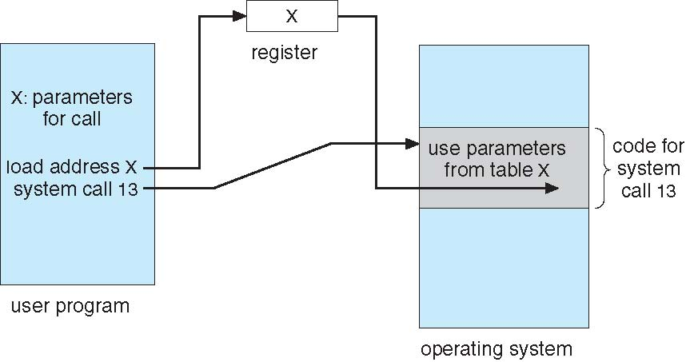
Go, change the world
Rules for passing Parameters for System Call
RV College of
Engineering
Three general methods used to pass parameters to the OS
1. Simplest: pass the parameters in registers
In some cases, may be more parameters than registers
2. Parameters stored in a block, or table, in memory, and address of block passed as a parameter in a register This approach taken by Linux and Solaris
3. Parameters should be pushed on or popped off the stack by the operating system

Slide 38
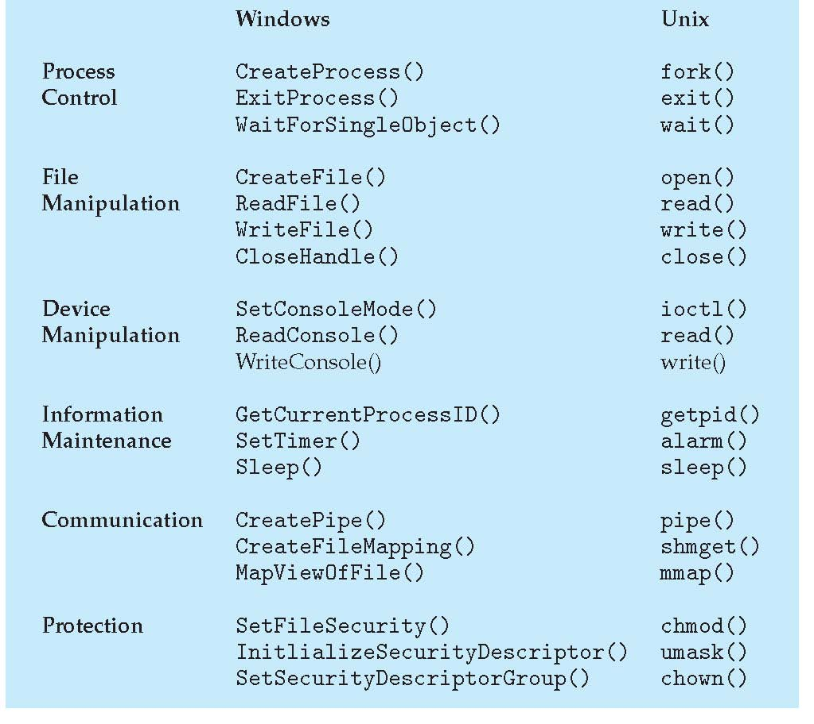
Go, change the world
Examples of Windows and Unix System Calls
RV College of
Engineering

Slide 39
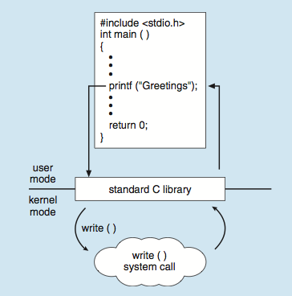
Go, change the world
RV College of
Engineering
C program invoking printf() library call, which calls write() system call
As an example, let’s assume a C program invokes the printf() statement. The C library intercepts this call and invokes the necessary system call (or calls) in the operating system—in this instance, the write() system call. The C library takes the value returned by write() and passes it back to the user program

Slide 40
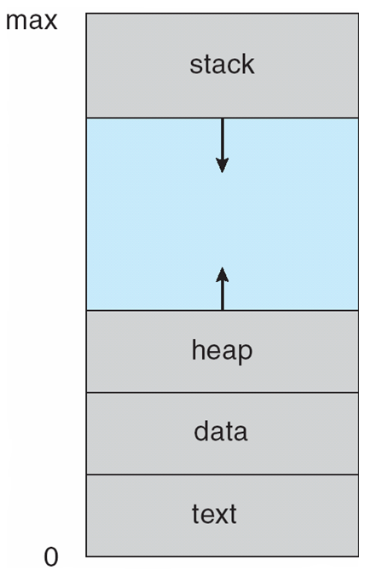
Go, change the world
RV College of
Engineering
Process Concept
Process – a program in execution;
Multiple parts
The program code, also called text section (Mainly Stores the Program)
Data section containing global and static variables
Heap containing memory dynamically allocated during run time
Current activity including program counter, processor registers
Stack containing temporary data
Function parameters, return addresses, local variables

Slide 41
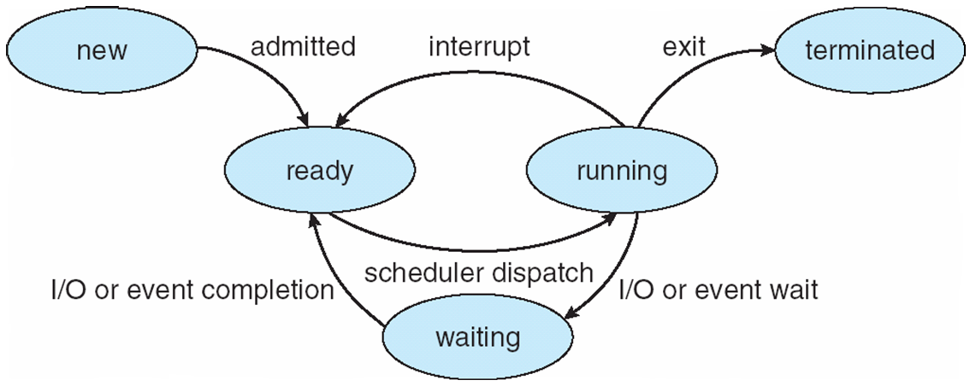
Go, change the world
Process State
RV College of
Engineering
As a process executes, it changes state,
The state of a process is defined in part by the current activity of that process
new: The process is being created (Program is ready for execution)
ready: The process is waiting to be assigned to a processor (Waiting for CPU)
running: Instructions are being executed
waiting: The process is waiting for some event to occur
terminated: The process has finished execution

Slide 42
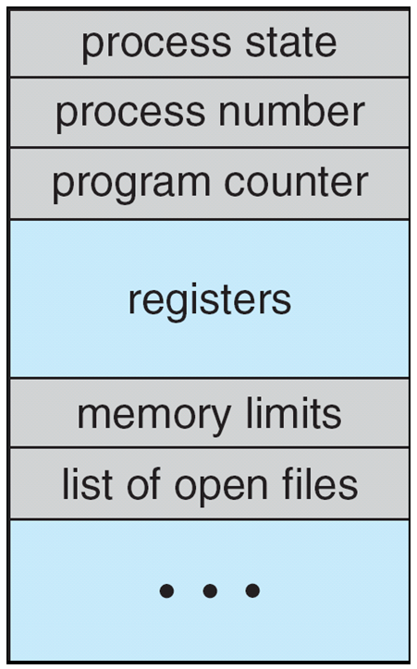
Go, change the world
Process Control Block (PCB)
RV College of
Engineering
Each Process is represented by the PCB (also called task control block)
Process state – running, waiting, etc
Program counter – location of instruction to next execute
CPU registers – Gives details of the registers used by the specific process
CPU scheduling information- priorities, scheduling queue pointers
(Basically determines which process should execute first)
Memory-management information – memory allocated to the process
Accounting information – CPU used, clock time elapsed since start, time limits
I/O status information – I/O devices allocated to process, list of open files

Slide 43
Go, change the world
Process Control Block (PCB)
RV College of
Engineering
Each Process is represented by the PCB (also called task control block)
Process state – running, waiting, etc
Program counter – location of instruction to next execute
CPU registers – Gives details of the registers used by the specific process
CPU scheduling information- priorities, scheduling queue pointers
(Basically determines which process should execute first)
Memory-management information – memory allocated to the process
Accounting information – CPU used, clock time elapsed since start, time limits
I/O status information – I/O devices allocated to process, list of open files

Slide 44
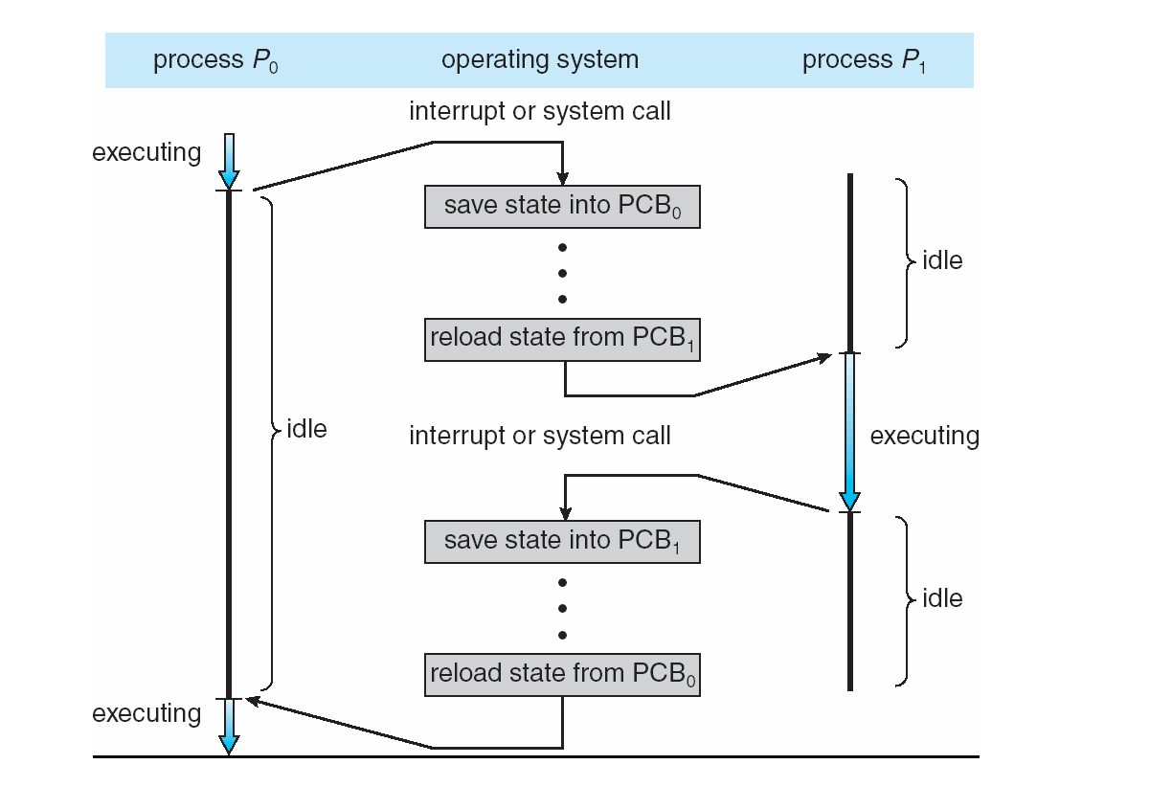
Go, change the world
CPU Switch From Process to Process
RV College of
Engineering

Slide 45
Go, change the world
RV College of
Engineering
Threads
What is a Thread? A thread is a path of execution within a process. A process can contain multiple threads.
For example, when a process is running a word-processor program, a single thread of instructions is being executed. This single thread of control allows the process to perform only one task at a time.
The user cannot simultaneously type in characters and run the spell checker within the same process, for example. Most modern operating systems have extended the process concept to allow a process to have multiple threads of execution and thus to perform more than one task at a time.
This feature is especially beneficial on multicore systems, where multiple threads can run in parallel.

Slide 46
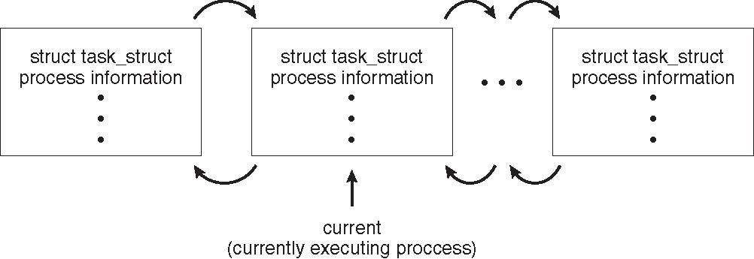
Go, change the world
RV College of
Engineering
Process Representation in Linux
The process control block in the Linux operating system is represented by the C structure task struct, which is found in the include file in the kernel source-code directory.
This structure contains all the necessary information for representing a process, including the state of the process, scheduling and memory-management information, list of open files, and pointers to the process’s parent.
The kernel maintains a pointer— current—to the process currently executing on the system.
If current is a pointer to the process currently executing, its state is changed with the following:
current->state = new state

Slide 47
Go, change the world
RV College of
Engineering
Process Representation in Linux
The process control block in the Linux operating system is represented by the C structure task struct, which is found in the include file in the kernel source-code directory.
This structure contains all the necessary information for representing a process, including the state of the process, scheduling and memory-management information, list of open files, and pointers to the process’s parent.
The kernel maintains a pointer— current—to the process currently executing on the system.
If current is a pointer to the process currently executing, its state is changed with the following:
current->state = new state

Slide 48
Go, change the world
RV College of
Engineering
Process Representation in Linux
The process control block in the Linux operating system is represented by the C structure task struct, which is found in the include file in the kernel source-code directory.
This structure contains all the necessary information for representing a process, including the state of the process, scheduling and memory-management information, list of open files, and pointers to the process’s parent.
The kernel maintains a pointer— current—to the process currently executing on the system.
If current is a pointer to the process currently executing, its state is changed with the following:
current->state = new state

Slide 49
Go, change the world
RV College of
Engineering
Process Scheduling
The objective of multiprogramming is to have some process running at all times, to maximize CPU utilization.
The objective of time sharing is to switch the CPU among processes so frequently that users can interact with each program.
To meet these objectives, the process scheduler selects an available process (possibly from a set of several available processes) for program execution on the CPU.
For a single-processor system, there will never be more than one running process. If there are more processes, the rest will have to wait until the CPU is free and can be rescheduled.
Process scheduler selects among available processes for next execution on CPU

Slide 50
Go, change the world
RV College of
Engineering
Fork () and Exec () System Calls
Fork () – System Call is used to create the separate duplicate process, the process that is created is called Child Process and from which it has been created is called Parent Process
After a new child process is created, both processes will execute the next instruction following the fork() system call.
A child process uses the same pc(program counter), same CPU registers, same open files which use in the parent process.
It takes no parameters and returns an integer value. Below are different values returned by fork().
Negative Value: creation of a child process was unsuccessful. Zero: Returned to the newly created child process. Positive value: Returned to parent or caller. The value contains process ID of newly created child process
Each of the Child Process Created will be having the different process ID (PID)
fork() creates a new process by duplicating the calling process, The new process, referred to as child, is an exact duplicate of the calling process, referred to as parent

Slide 51
Go, change the world
RV College of
Engineering
Fork () and Exec () System Calls
#include <stdio.h>
#include <sys/types.h>
#include <unistd.h>
int main()
{
// fork(); Total Number of Processes = 2^{n}
print("Hello world!\n");
return 0;
}
Output
Without fork()
Hello world
With fork()
Hello world
Hello world

Slide 52
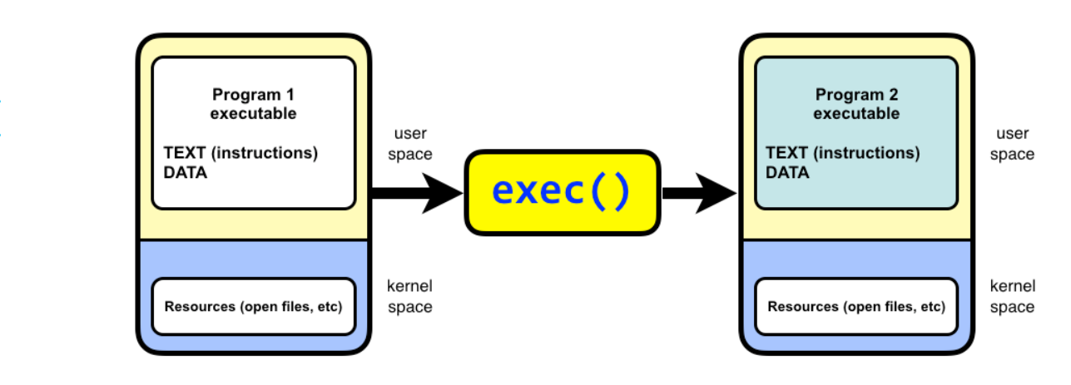
Go, change the world
RV College of
Engineering
Exec () System Calls
The exec system call is used to execute a file which is residing in an active process. When exec is called the previous executable file is replaced and new file is executed.
More precisely, we can say that using exec system call will replace the old file or program from the process with a new file or program. The entire content of the process is replaced with a new program.
Process id PID is not changed,

Slide 53
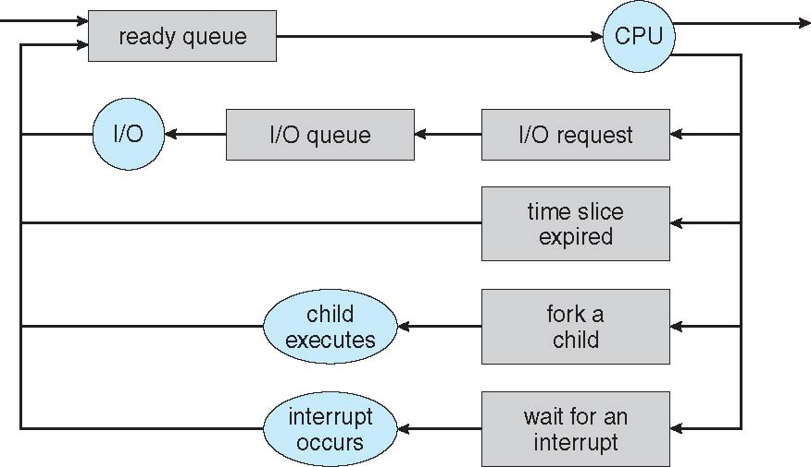
Go, change the world
RV College of
Engineering
Scheduling Queues
Job queue – List of all the process that are present in the system. The Job queue resides in Secondary Memory
Ready queue –List of all the processes residing in main memory, ready and waiting to execute.
Device queues – List of the processes waiting for an I/O device
Time Slice Expired : Process will execute for certain period of
Time and go backs to ready queue
Processes migrate among the various queues

Slide 54
Go, change the world
RV College of
Engineering
Schedulers
A process migrates among the various scheduling queues throughout its lifetime.
The operating system must select, for scheduling purposes, processes from these queues in some fashion
The primary distinction between these two schedulers lies in frequency of execution
Long-term scheduler (or Job scheduler) – selects which processes should be brought into the ready queue from Job queue
Long-term scheduler is invoked infrequently (seconds, minutes) ⇒ (may be slow)
The long-term scheduler controls the degree of multiprogramming(the average rate of process creation must be equal to the average departure rate of processes leaving the system
Short-term scheduler (or CPU scheduler) – selects which process should be executed next and allocates CPU
Sometimes the only scheduler in a system
Short-term scheduler is invoked frequently (milliseconds) ⇒ (must be fast)
Processes can be described as either:
I/O-bound process – spends more time doing I/O than computations
CPU-bound process – spends more time doing computations
Long-term scheduler strives for good process mix

Slide 55
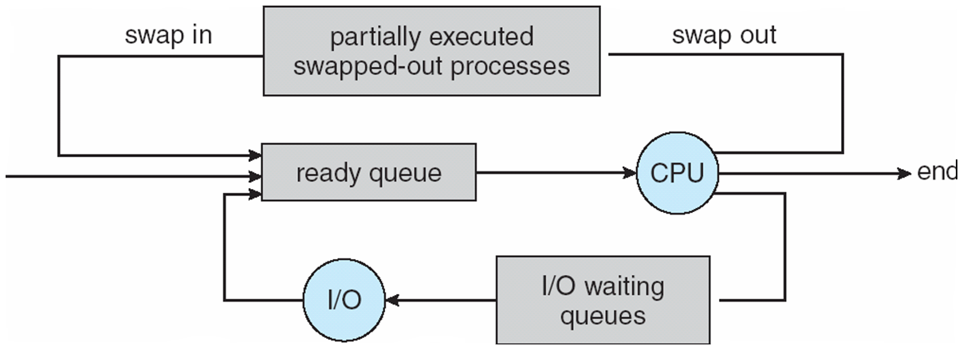
Go, change the world
RV College of
Engineering
Schedulers
Medium-term scheduler can be added if degree of multiple programming needs to decrease
Remove process from memory, store on disk, bring back in from disk to continue execution: swapping

Slide 56
Go, change the world
RV College of
Engineering
Context Switch
When CPU switches to another process, the system must save the state of the old process and load the saved state for the new process via a context switch
Context of a process represented in the PCB
Context-switch time is overhead; the system does no useful work while switching
Context-switch time is pure overhead, because the system does no useful work while switching. Switching speed varies from machine to machine, depending on the memory speed, the number of registers that must be copied, and the existence of special instructions
Time dependent on hardware support

Slide 57
Go, change the world
RV College of
Engineering
Multitasking in Mobile Systems
Some mobile systems (e.g., early version of iOS) allow only one process to run, others suspended
Due to screen real estate, user interface limits iOS provides for a
Single foreground process- controlled via user interface (appearing on the display)
Multiple background processes– in memory, running, but not on the display, and with limits
Limits include single, short task, receiving notification of events, specific long-running tasks like audio playback
Android runs foreground and background, with fewer limits
Background process uses a service to perform tasks
Service can keep running even if background process is suspended
Service has no user interface, small memory use

Slide 58
Go, change the world
RV College of
Engineering
Operations on Processes (Process Creation)
Parent process create children processes, which, in turn create other processes, forming a tree of processes
Generally, process identified and managed via a process identifier (pid)
Resource sharing options
1. Parent and children share all resources
2 Children share subset of parent’s resources
3. Parent and child may not share the resources, child may directly take the resources from operating system
Execution options
1. Parent and children execute concurrently
2.Parent waits until children terminate

Slide 59
Go, change the world
RV College of
Engineering
Operations on Processes (Process Creation)

Slide 60
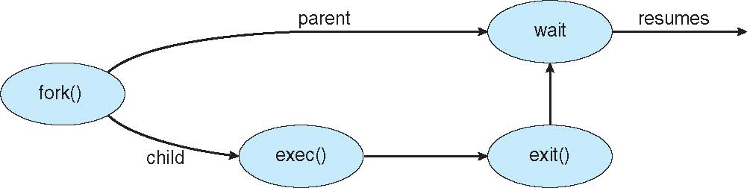
Go, change the world
RV College of
Engineering
Operations on Processes (Process Creation)
Address space
1. Child duplicate of parent (Basically Child contains all the instructions as parent)
2. Child has a program loaded into it (New Process can be loaded into the child)
UNIX examples
fork() system call creates new process
exec() system call used after a fork() to replace the process’ memory space with a new program

Slide 61
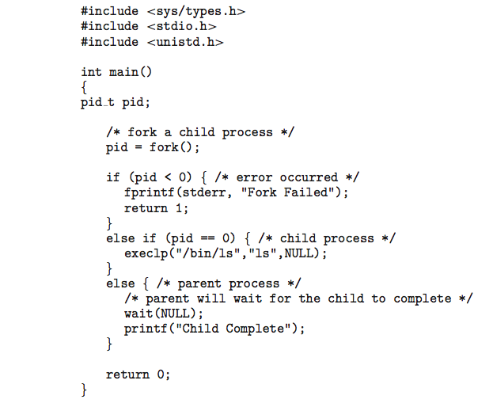
Go, change the world
RV College of
Engineering
C Program Forking Separate Process

Slide 62
Go, change the world
RV College of
Engineering
Process Termination
Process executes last statement and then asks the operating system to delete it using the exit() system call.
Returns status data from child to parent via wait())
Process’ resources are deallocated by operating system
Parent may terminate the execution of children processes using the abort() system call. Some reasons for doing so:
Child has exceeded allocated resources
Task assigned to child is no longer required
The parent is exiting and the operating systems does not allow a child to continue if its parent terminates

Slide 63
Go, change the world
RV College of
Engineering
Process Termination
Some operating systems do not allow child to exists if its parent has terminated. If a process terminates, then all its children must also be terminated cascading termination. All children, grandchildren, etc. are terminated.
The termination is initiated by the operating system.
The parent process may wait for termination of a child process by using the wait()system call. The call returns status information and the pid of the terminated process
process may return a status value (typically an integer) to its parent process (via the wait() system call)
pid = wait(&status);
If no parent waiting (did not invoke wait()) process is a zombie
If parent terminated without invoking wait , process is an orphan

Slide 64
Go, change the world
RV College of
Engineering
SUMMARY
Introduction What Operating System do, Operating System structure, Operating system Operations.
System Structures Operating system services, System Calls, Types of System calls
Process Management Process concept, Process scheduling, Operations on processes

